Slide 1
Respiration
1

Slide 2
OXYGEN
INHALING
EXHALING
CARBONDIOXIDE
RESPIRATORY SYSTEM
LUNGS
BLOOD
TRANSPIRATION
PHOTOSYNTHESIS
OZONE
TRACHEA
CORONA VIRUS
CHLOROPHYLL
STOMATA

Slide 3
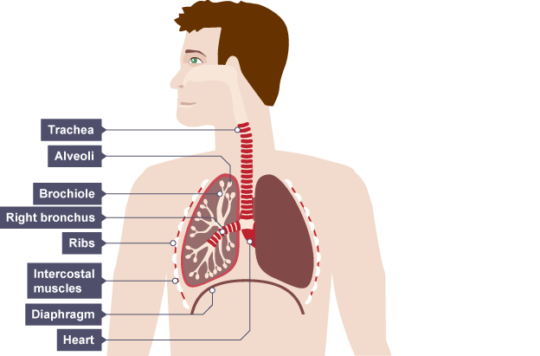
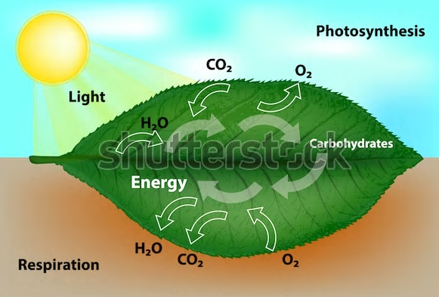

Slide 4
Why do we respire? All the living organisms are made up of small microscopic units called the cells. These cells have different functions to perform in these organisms such as digestion, respiration, transportation and excretion. The cells can perform this function only if they get the energy to do so. Hence, all living organisms need food which gives them the required energy. The energy present in the food gets released when the organisms respire or breathe. .
5/26/2020
TOPIC/COURSE CODE-NAME/FACULTY/DEPT/COLLEGE
2/10

Slide 5
RESPIRATION AND OXIDATION Energy is released from digested food through the process of respiration. The nutrients of the digested food react with oxygen in the body cells to release energy. The reaction with oxygen is known as oxidation. Respiration is the process of taking in oxygen, using it for release of energy by oxidation of food, and eliminating the waste products—carbon dioxide and water.
5/26/2020
TOPIC/COURSE CODE-NAME/FACULTY/DEPT/COLLEGE

Slide 6
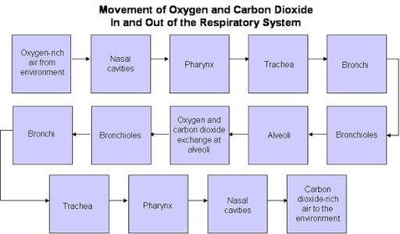
PATH OF EXTERNAL RESPIRATION IN ANIMALS
5/26/2020
TOPIC/COURSE CODE-NAME/FACULTY/DEPT/COLLEGE
3/10

Slide 7
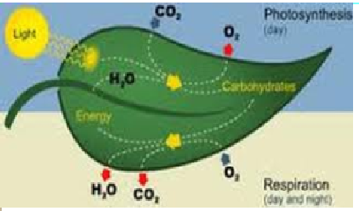
PATH OF EXTERNAL REPIRATION IN ANIMALS

Slide 8
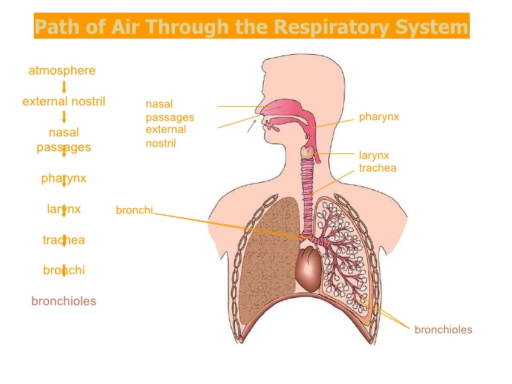
The two main processes of respiration are: External respiration or breathing, i.e. taking in air rich in oxygen (inhalation) and giving out air rich in carbon dioxide (exhalation). Internal respiration or cellular respiration, i.e. using oxygen to break down food to release energy. Internal respiration occurs in the body cells.
5/26/2020
TOPIC/COURSE CODE-NAME/FACULTY/DEPT/COLLEGE

Slide 9
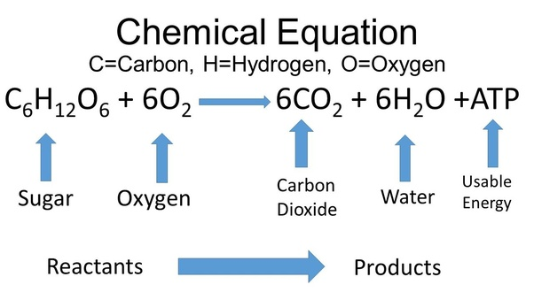
RESPIRATION In respiration, glucose molecules react with oxygen and break down into carbon dioxide and water to release energy. The chemical reaction involved in respiration is summarized here:
5/26/2020
TOPIC/COURSE CODE-NAME/FACULTY/DEPT/COLLEGE
6/10

Slide 10
